Slide 1
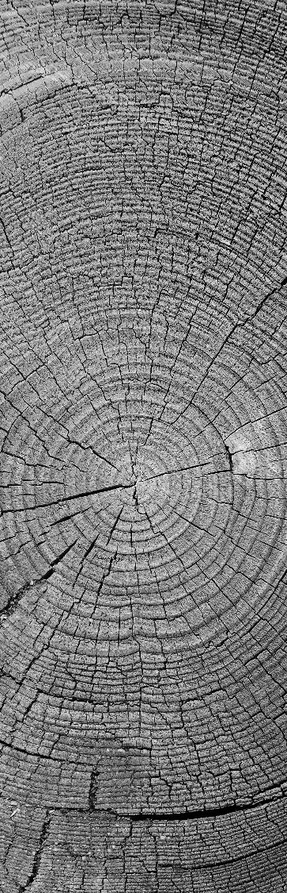
Gridding and Optimization for a Drone Swarm
The National Institute of Engineering Mysore
Adithya Sanjeev B
Prathvi Rao
Sanjana Raj

Slide 2
Introduction
The Big Picture

Slide 3
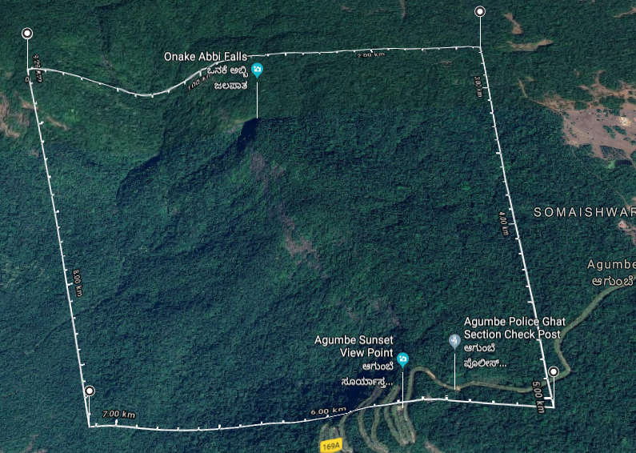


The aim of the integrated project
Goal is to complete a mission by navigating autonomously and share vital information.
The main purpose of the these drone is to scout the disaster areas or inaccessible terrain areas and report with the relevant data to the Cloud Data Centre for any analytics and processing.

Slide 4

Literature Survey
Sources for our research.
KML: https://developers.google.com/kml/documentation/kmlreference
QGIS: https://qgis.org/en/docs/index.html
Polygon Splitting Algorithm: http://www.khetarpal.org/polygon-splitting/
PyQGIS Developer Cookbook: https://docs.qgis.org/testing/en/docs/pyqgis_developer_cookbook/
M´arton G´otzy, D´aniel Het´enyi, L´aszl´o Bl´azovics, “Aerial Surveillance System with Cognitive Swarm Drones”, 28th International Conference 2016 Cybernetics and Informatics (K&I), Levoca, Slovakia

Slide 5

Gridding
Problem Statement and Formulation

Slide 6
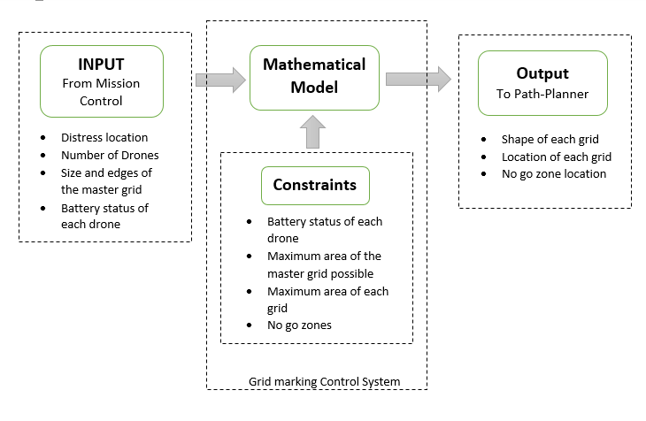
Block diagram

Slide 7
Tool survey
KML (Keyhole Mark-up Language): KML is used to pinpoint the location, add image overlay etc. Similar to XML. Have basic non predefined tags like points, co-ordinates etc.
QGIS: Geographic Information System is designed to capture, store geographical data. QGIS is a framework used on top of GIS. This includes an inbuilt map which gives the values like the type of terrain, altitude etc. data at a given location. This can be included in python script and can depict the mathematical modelled values easily on to the map. This also consists of static map and gridding capabilities
Python Libraries:
PyKML
FastKML
Geographic Library
SimpleKML

Slide 8
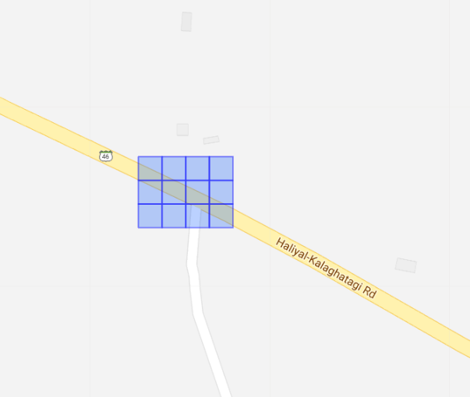
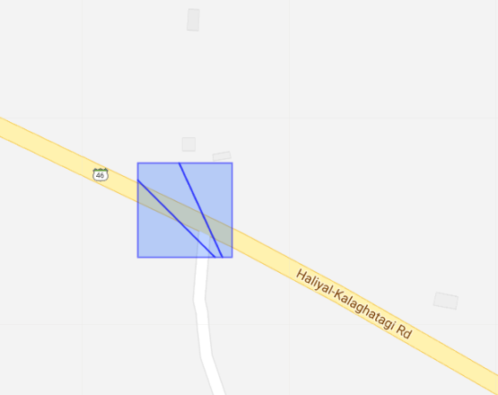
Implementation
The algorithms used for dividing the master gird
Area Division
Line Division

Slide 9
tools
Tools used
KML: https://developers.google.com/kml/documentation/kmlreference
QGIS: https://qgis.org/en/docs/index.html
SimpleKML: https://simplekml.readthedocs.io/en/latest/
Geographic Library: https://geographiclib.sourceforge.io/html/python/
pyKML: https://pythonhosted.org/pykml/

Slide 10
THANK YOU
WOODGROVE BANK

